Slide 1
Classification of Galaxy Emission Lines
Hashir Qureshi

Slide 2
Background
HETDEX (Hobby-Eberly Telescope Dark Energy eXperiment) - Spectroscopic galaxy survey
Aims to find Lyman Alpha galaxies (LAEs) at redshift range of 1.9 - 3.5
Lyman Alpha - emission line generated from change in energy levels in Hydrogen
Wavelength of 1,216 Å
One of the most luminous emission lines
Good way to study galaxies far away
Hurdle - Singly Ionized Oxygen (OII) emission line at redshift < 0.56
Wavelength of 3,727 Å

Slide 3
Redshifting
Object travels away from us - wavelength of light gets longer
Observation of Spectra becomes tricky
High redshift LAE overlaps low redshift OII

Slide 4
???
LAE?
OII?

Slide 5
Plan of Action
Balanced Data - clean (for the most part) - 116,952 instances and 15 features
Random Forest classification algorithm
Compare precision scores (5-fold cross validation) with other classification algorithms using default parameters
Decision Trees
Extra Random Trees
Support Vector Machines!
Troubleshoot
High Variance/Bias
Less important features creating noise
Optimize if needed

Slide 6
Results
Random Forest
Score - 98.1%!!
Standard Deviation - 0.075%
Decision Trees
Score - 96.6%
Standard Deviation - 0.118%
Extra Random Trees
Score - 98.5%
Standard Deviation - .081%
Support Vector Machines
Score - 82.2%
Standard Deviation - .353%

Slide 7
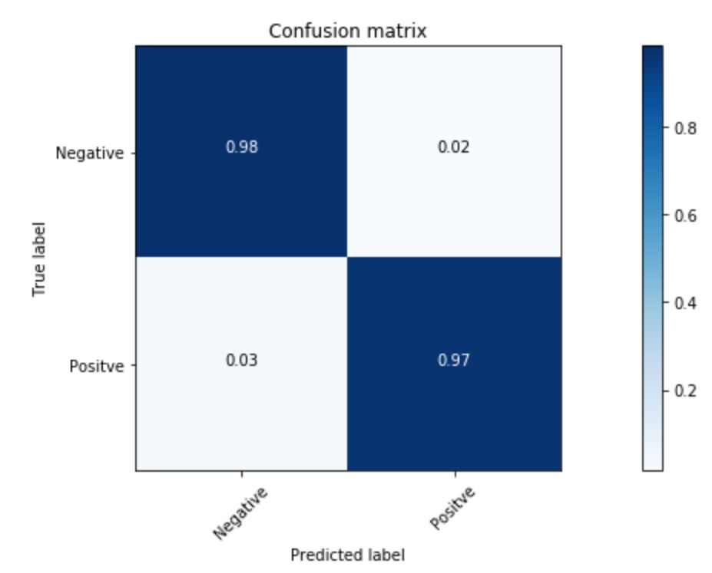
For Random Forest

Slide 8
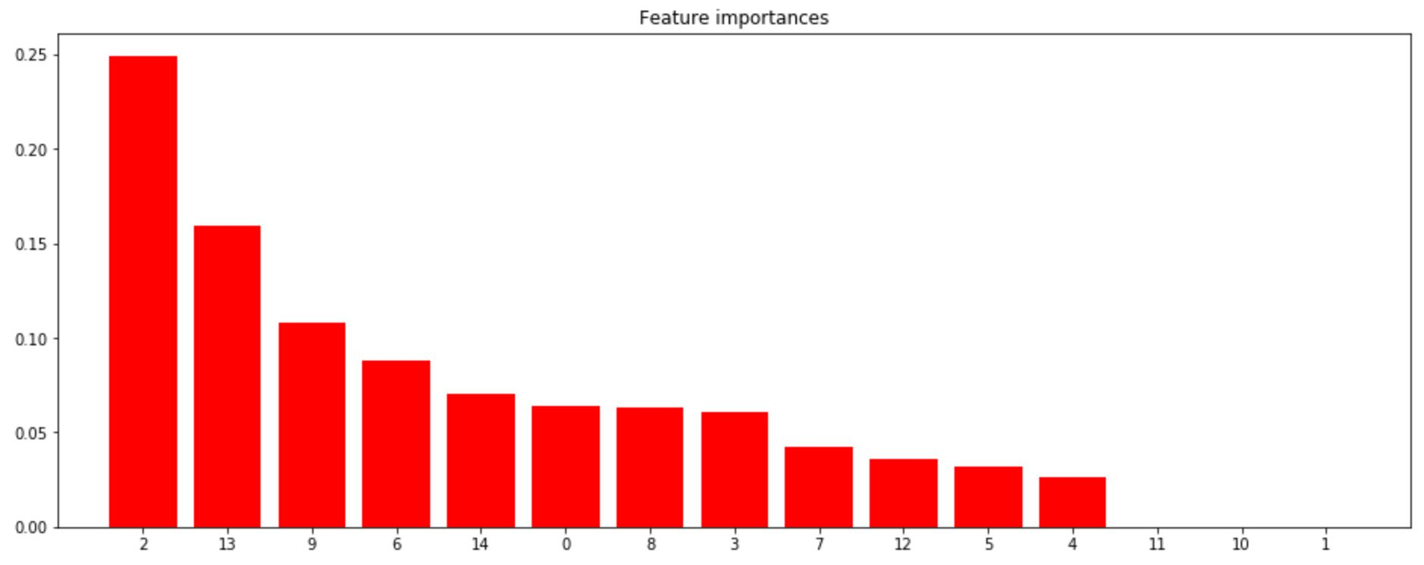
Random Forest

Slide 9
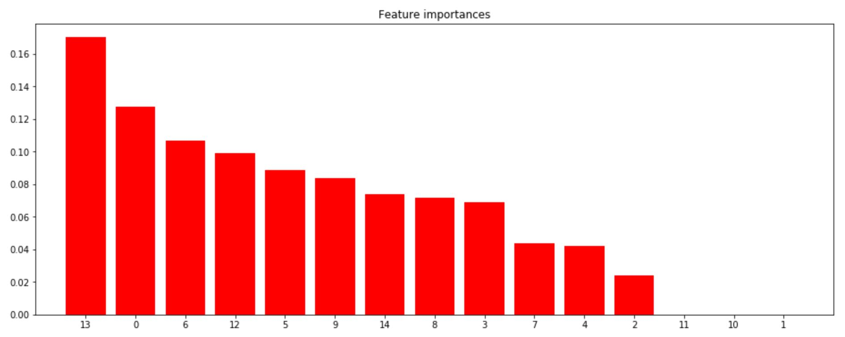
Extra Random Trees

Slide 10
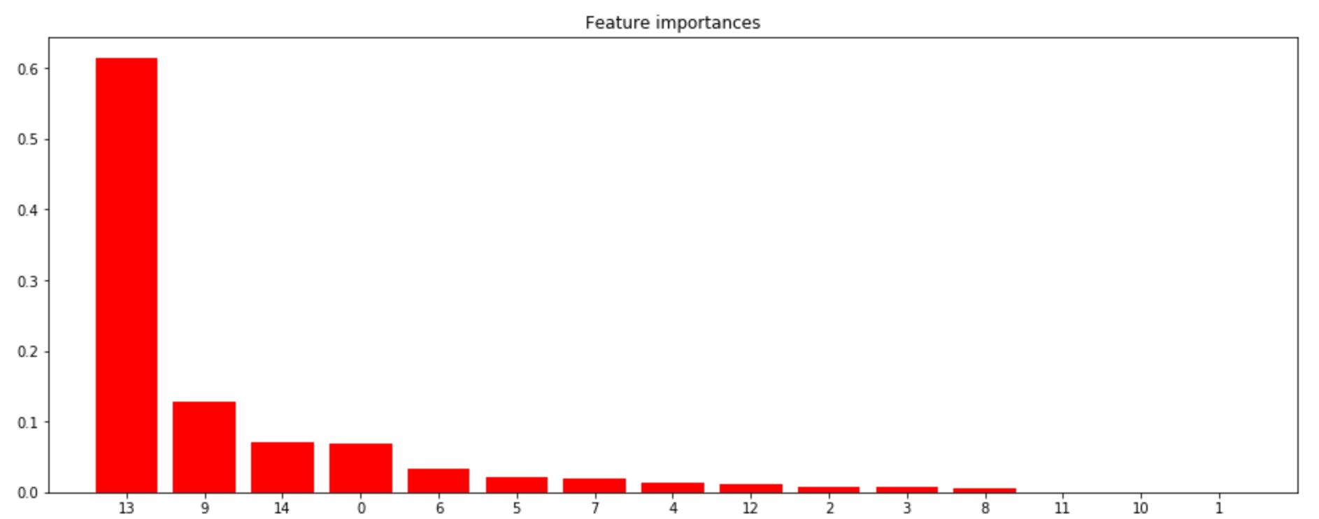
Decision Trees

Slide 11
Conclusions
Data from simulations!
Full observational data will probably change results
No need to Optimize - I tried it
SVC too slow - no need to waste time currently

Slide 12


